Slide 1

INTEL ARRIA 10 GX DEV KIT
PCIE GEN3x8 DMA
ON NVIDIA XAVIER SYSTEM
10/7/2019
1
Copyright © 2019 EBots Inc.
hlam@ebots.com/mkang@ebots.com
Notes:
Send RAW8 pixel format
Distortion will be done at software side
NxWxH: round-robin buffer
Frame ID, Beginning of Frame, End of Frame, status flag → when it is done
Data arrangement: Frame1[ABC…]Frame2[ABC…]Frame3[ABC…]… → [AAAA…BBBBB…CCCC….] → for 3D image only, for 2D frame arrangement
Dead Pixel detection
DMA bandwidth
1

Slide 2
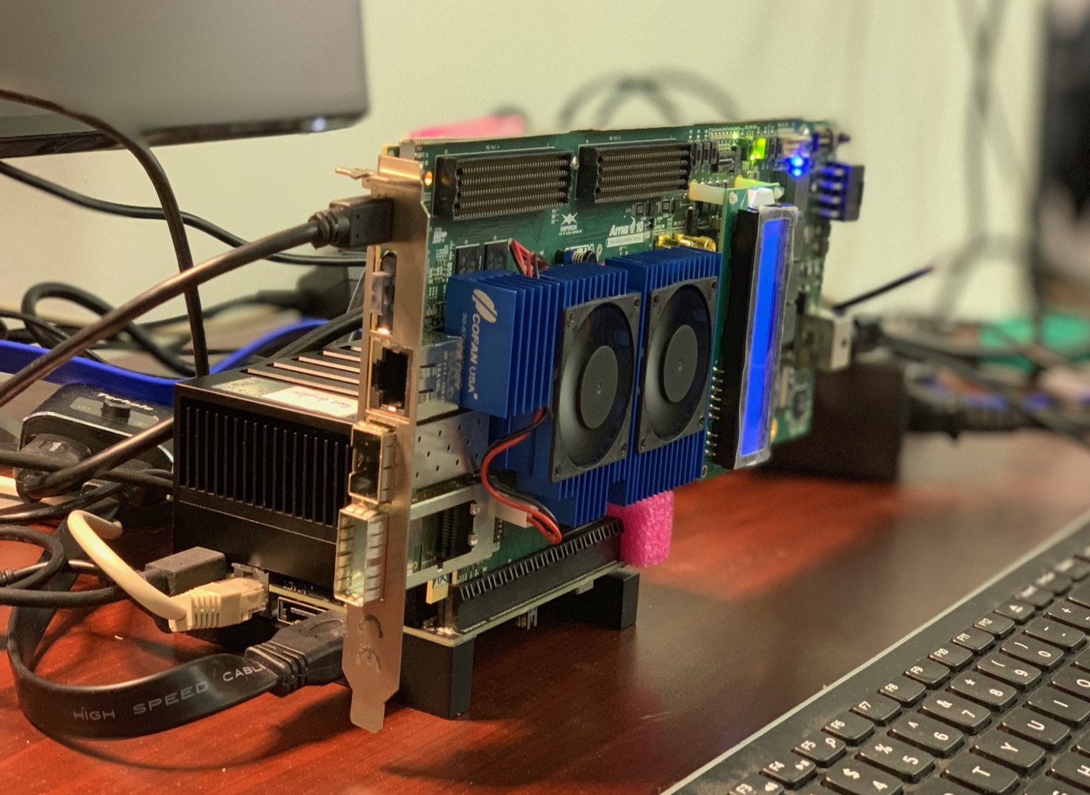
INTEL ARRIA 10 GX DEV KIT – PCIE GEN3x8 DMA
System Set-Up
Nvidia Jetson Xavier PCIe Root Port
FPGA ARRIA 10 GX Dev Kit
OS: Ubuntu 18.04 Release tegra-l4t-r32.2.0
Quartus Prime Pro 19.2
10/7/2019
2
Copyright © 2019 EBots Inc.
hlam@ebots.com/mkang@ebots.com
Notes:
2

Slide 3
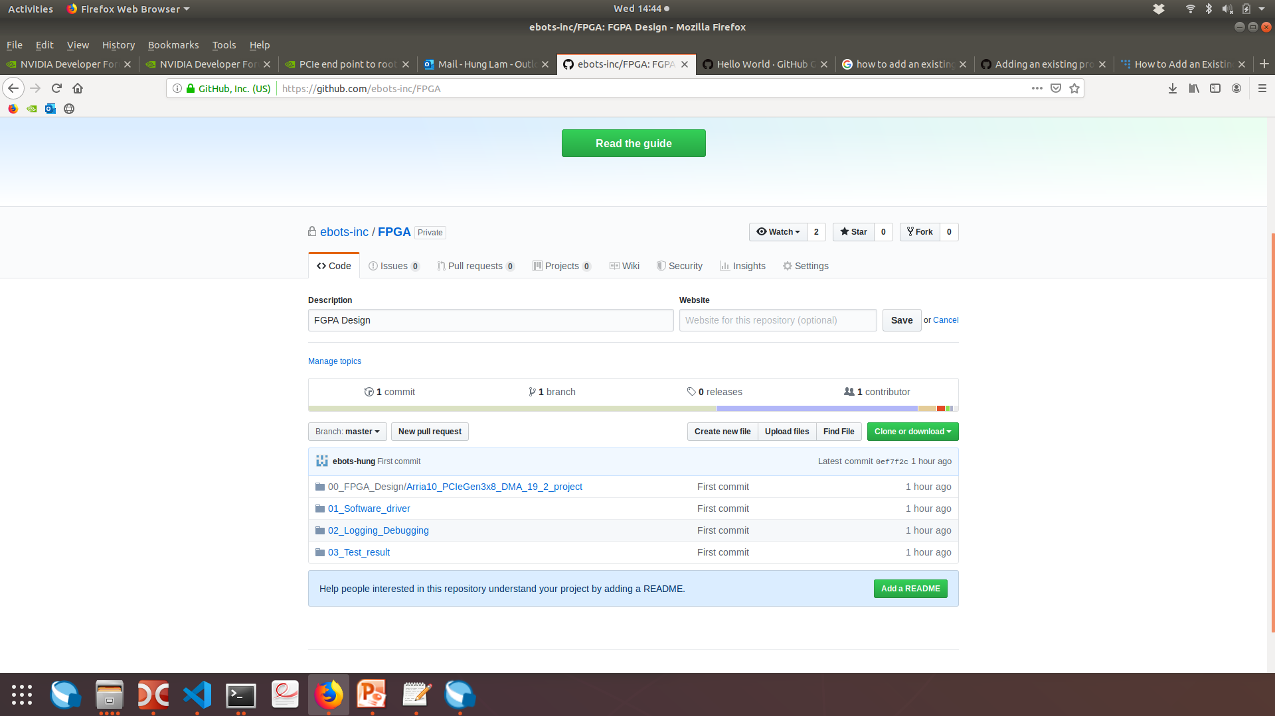
INTEL ARRIA 10 GX DEV KIT – PCIE GEN3x8 DMA
GITHUB – Configuration Management
https://github.com/ebots-inc/FPGA
10/7/2019
3
Copyright © 2019 EBots Inc.
hlam@ebots.com/mkang@ebots.com
Notes:
3

Slide 4
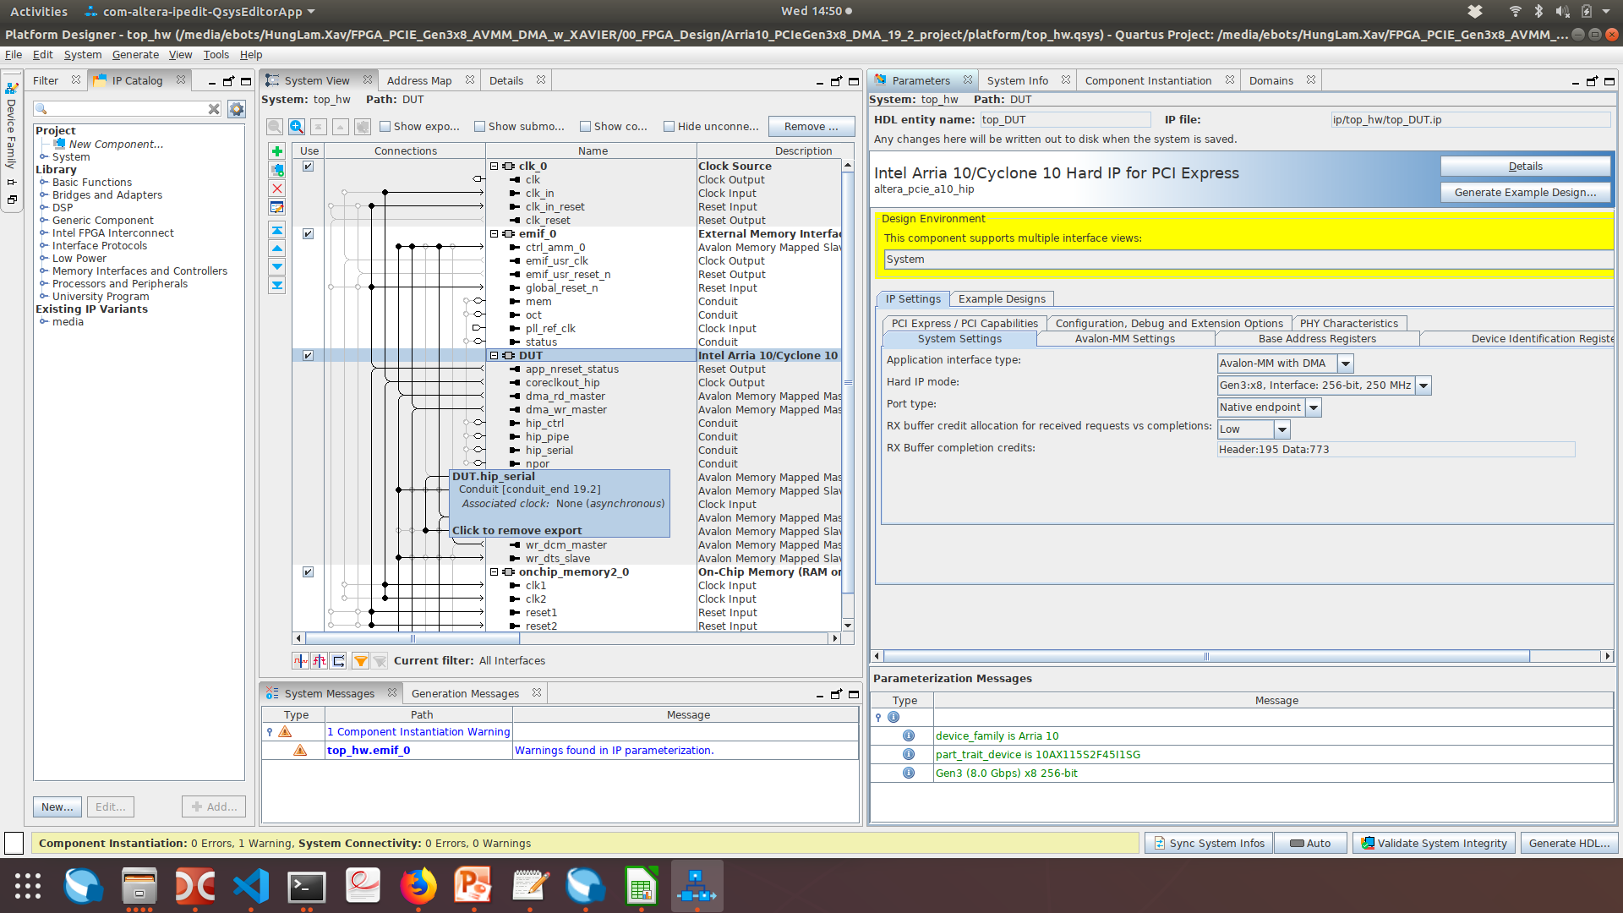
INTEL ARRIA 10 GX DEV KIT – PCIE GEN3x8 DMA
FPGA – Hard IP PCIE Configuration
App I/F: Avalon-MM with DMA
IP mode: Gen3:x8, i/f 256 bit, 250Mhz
Port: Native Endpoint
10/7/2019
4
Copyright © 2019 EBots Inc.
hlam@ebots.com/mkang@ebots.com
Notes:
4

Slide 5
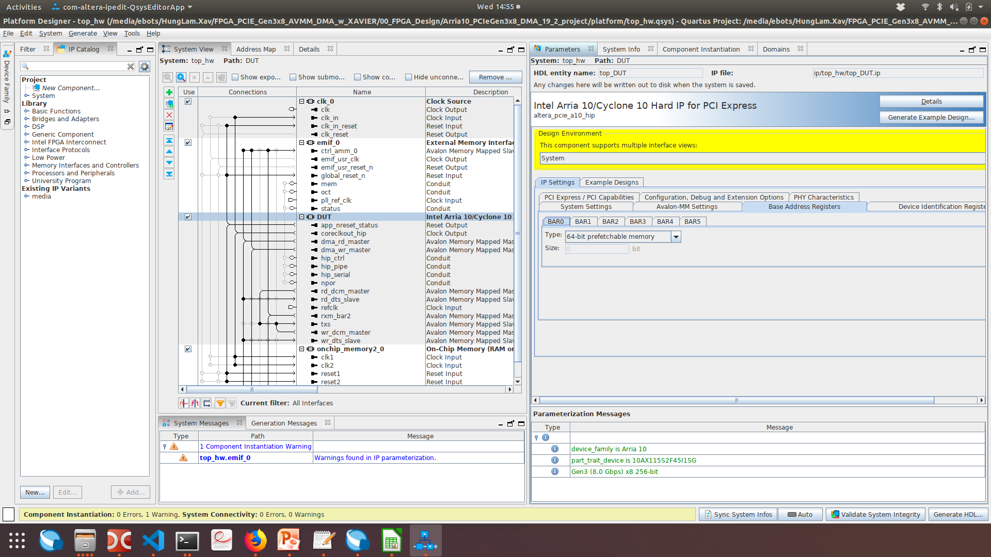
INTEL ARRIA 10 GX DEV KIT – PCIE GEN3x8 DMA
FPGA – Hard IP PCIE Configuration (cont.)
BAR0: 64-bit prefetchable memory
BAR2: 64-bit prefetchable memory
BAR1,3,4,5: disable
10/7/2019
5
Copyright © 2019 EBots Inc.
hlam@ebots.com/mkang@ebots.com
Notes:
5

Slide 6
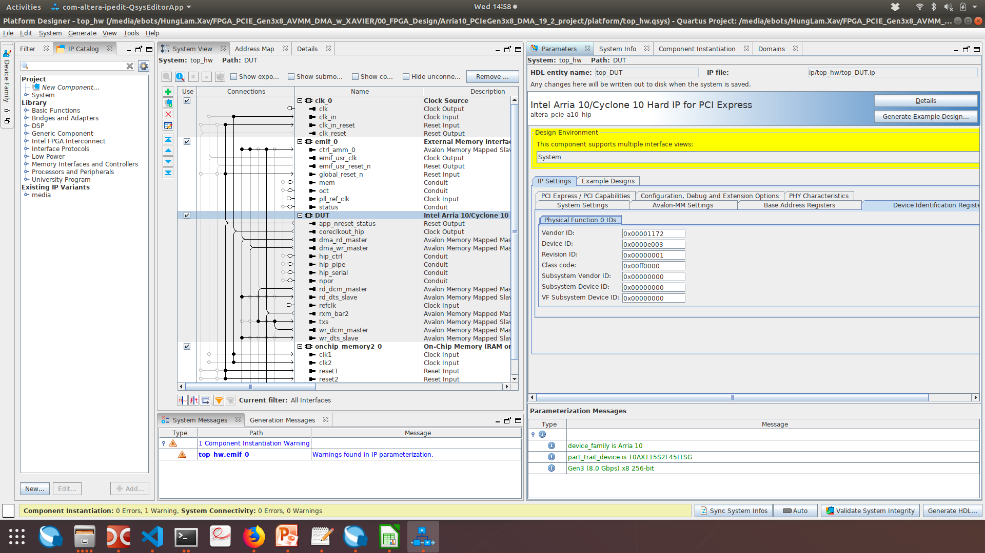
INTEL ARRIA 10 GX DEV KIT – PCIE GEN3x8 DMA
FPGA – Hard IP PCIE Configuration (cont.)
Vendor ID: 0x1172 → Intel ID
Device ID: 0xe003
Revision ID: 0x1
Class code: 0x00ff0000
10/7/2019
6
Copyright © 2019 EBots Inc.
hlam@ebots.com/mkang@ebots.com
Notes:
6

Slide 7
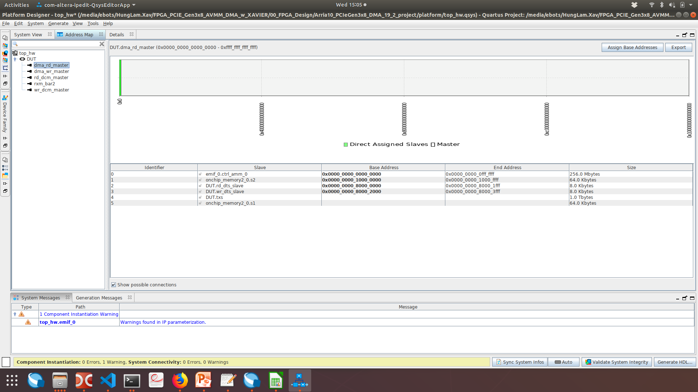
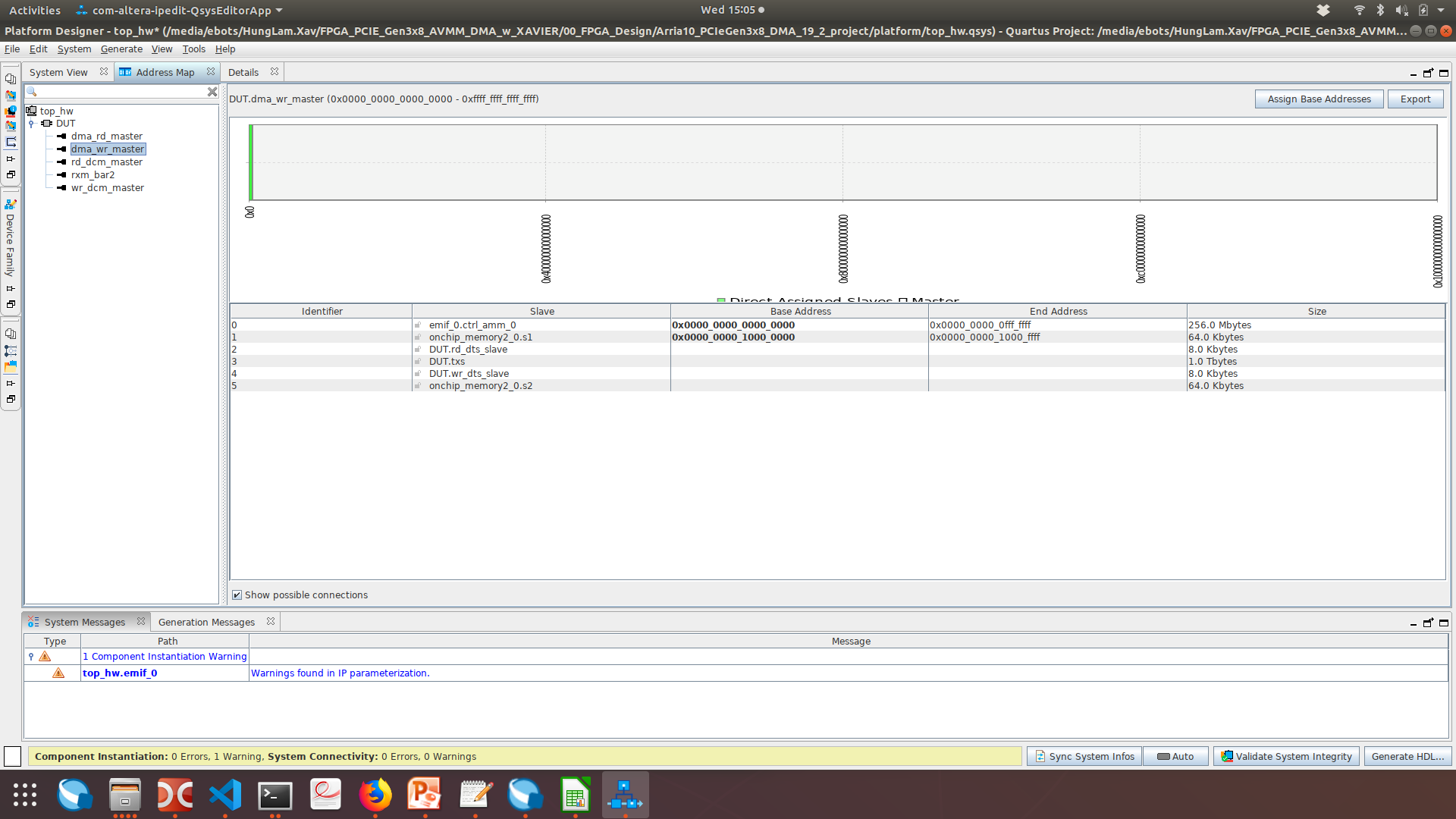
INTEL ARRIA 10 GX DEV KIT – PCIE GEN3x8 DMA
FPGA – Memory Map
dma_rd_master: 0x0000_0000_0000_0000 → 0xffff_ffff_ffff_ffff
dma_wr_master: 0x0000_0000_0000_0000 → 0xffff_ffff_ffff_ffff
10/7/2019
7
Copyright © 2019 EBots Inc.
hlam@ebots.com/mkang@ebots.com
Notes:
7

Slide 8
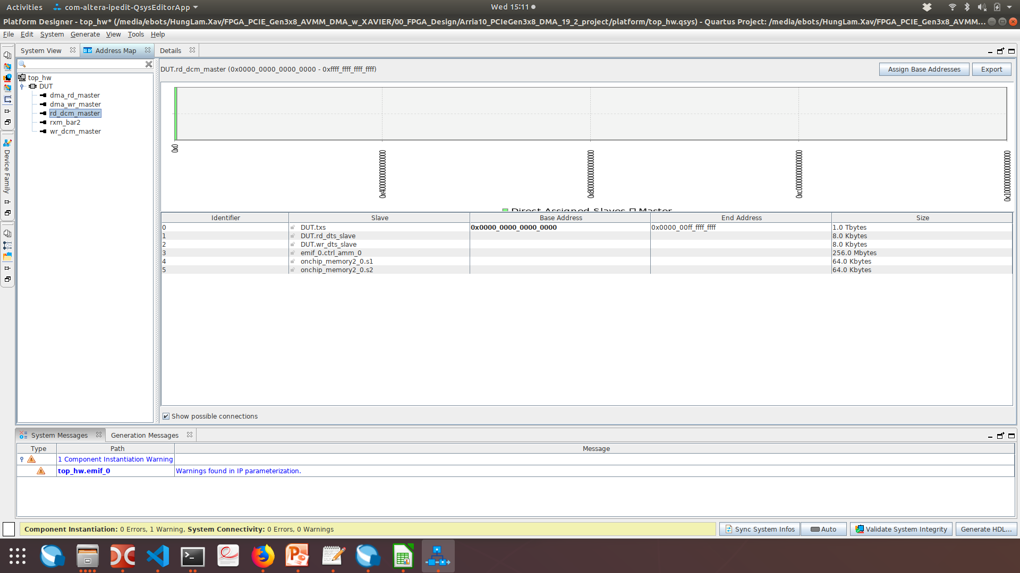

INTEL ARRIA 10 GX DEV KIT – PCIE GEN3x8 DMA
FPGA – Memory Map (cont.)
rd_dcm_master: 0x0000_0000_0000_0000 → 0xffff_ffff_ffff_ffff
wr_dcm_master: 0x0000_0000_0000_0000 → 0xffff_ffff_ffff_ffff
10/7/2019
8
Copyright © 2019 EBots Inc.
hlam@ebots.com/mkang@ebots.com
Notes:
8

Slide 9

INTEL ARRIA 10 GX DEV KIT – PCIE GEN3x8 DMA
FPGA – Memory Map (cont.)
Rxm_bar2: 0x0000_0000_0000_0000 → 0xffff_ffff_ffff_ffff
Slave | Base Addr. | End Addr. | Size
Emif_0.ctrl_amm_0 | 0x0000_0000_0000_0000 | 0x0000_0000_0fff_ffff | 256MB
Onchip_memory2_0.s1 | 0x0000_0000_1000_0000 | 0x0000_0000_1000_ffff | 64KB
Rd_dts_slave |  |  | 8KB
txs |  |  | 1TB
10/7/2019
9
Copyright © 2019 EBots Inc.
hlam@ebots.com/mkang@ebots.com
Notes:
9

Slide 10
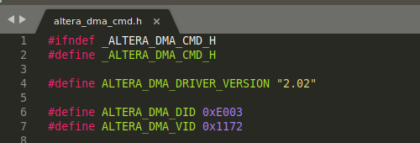
INTEL ARRIA 10 GX DEV KIT – PCIE GEN3x8 DMA
NVIDA JETSON XAVIER – PCIE device driver
IDs matching
10/7/2019
10
Copyright © 2019 EBots Inc.
hlam@ebots.com/mkang@ebots.com
Notes:
10

Slide 11
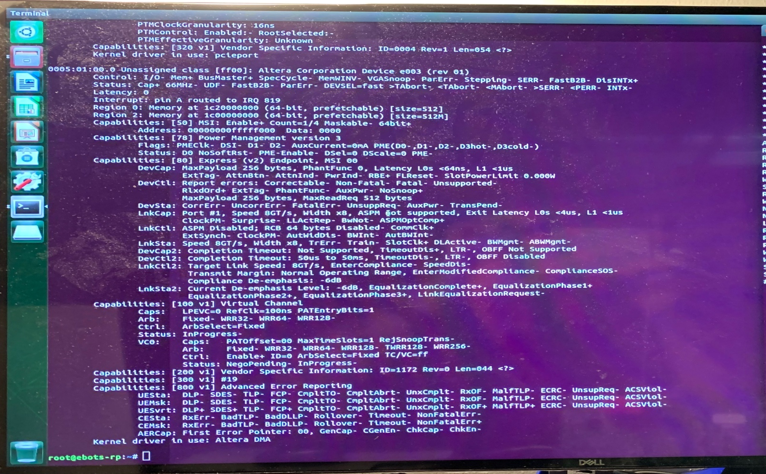
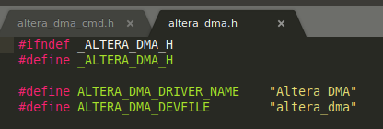
INTEL ARRIA 10 GX DEV KIT – PCIE GEN3x8 DMA
NVIDA JETSON XAVIER – PCIE device list
BAR0, BAR2 mapped successfully
PCIe max-speed: 8GT/s
$ sudo lspci -vvvv
10/7/2019
11
Copyright © 2019 EBots Inc.
hlam@ebots.com/mkang@ebots.com
Notes:
11

Slide 12
INTEL ARRIA 10 GX DEV KIT – PCIE GEN3x8 DMA
NVIDA JETSON XAVIER – System Log
[ 9.237954] pcie-tegra.c:nvidia,max-speed is 4 | NOTE: 1: Gen1, 2: Gen2, 3: Gen3, 4: Gen4
[ 9.238134] tegra-pcie-dw 141a0000.pcie: PCIe max-speed check
[ 9.239524] tegra-pcie-dw 141a0000.pcie: Setting init speed to max speed
[ 9.241998] OF: PCI: host bridge /pcie@141a0000 ranges:
[ 9.243436] OF: PCI: IO 0x3a100000..0x3a1fffff -> 0x3a100000
[ 9.244864] OF: PCI: MEM 0x1f40000000..0x1fffffffff -> 0x40000000
[ 9.248309] OF: PCI: MEM 0x1c00000000..0x1f3fffffff -> 0x1c00000000
[ 9.877487] tegra-pcie-dw 141a0000.pcie: link is up
[ 9.879186] tegra-pcie-dw 141a0000.pcie: PCI host bridge to bus 0005:00
[ 9.880634] pci_bus 0005:00: root bus resource [bus 00-ff]
[ 9.882050] pci_bus 0005:00: root bus resource [io 0x300000-0x3fffff] (bus address [0x3a100000-0x3a1fffff])
[ 9.883533] pci_bus 0005:00: root bus resource [mem 0x1f40000000-0x1fffffffff] (bus address [0x40000000-0xffffffff])
[ 9.885015] pci_bus 0005:00: root bus resource [mem 0x1c00000000-0x1f3fffffff pref]
….
[ 9.888533] pci 0005:01:00.0: [1172:e003] type 00 class 0xff0000
[ 9.888645] pci 0005:01:00.0: reg 0x10: [mem 0x00000000-0x000001ff 64bit pref]
[ 9.888717] pci 0005:01:00.0: reg 0x18: [mem 0x00000000-0x1fffffff 64bit pref]
[ 9.889528] iommu: Adding device 0005:01:00.0 to group 64
[ 9.902405] pci 0005:00:00.0: BAR 15: assigned [mem 0x1c00000000-0x1c2fffffff 64bit pref]
[ 9.904273] pci 0005:01:00.0: BAR 2: assigned [mem 0x1c00000000-0x1c1fffffff 64bit pref]
[ 9.906370] pci 0005:01:00.0: BAR 0: assigned [mem 0x1c20000000-0x1c200001ff 64bit pref]
[ 9.907790] pci 0005:00:00.0: PCI bridge to [bus 01-ff]
[ 9.909119] pci 0005:00:00.0: bridge window [mem 0x1c00000000-0x1c2fffffff 64bit pref]
[ 9.910515] pci 0005:00:00.0: Max Payload Size set to 256/ 256 (was 256), Max Read Rq 512
[ 9.911969] pci 0005:01:00.0: Max Payload Size set to 256/ 256 (was 128), Max Read Rq 512
10/7/2019
12
Copyright © 2019 EBots Inc.
hlam@ebots.com/mkang@ebots.com
Notes:
12

Slide 13
INTEL ARRIA 10 GX DEV KIT – PCIE GEN3x8 DMA
NVIDA JETSON XAVIER – System Log
[ 317.624493] altera_dma: loading out-of-tree module taints kernel.
[ 317.625486] Altera DMA: altera_dma_init(), Aug 14 2019 10:45:01
[ 317.625831] Altera DMA 0005:01:00.0: enabling device (0000 -> 0002)
[ 317.625867] Altera DMA 0005:01:00.0: pci_enable_device() successful
[ 317.626173] Altera DMA 0005:01:00.0: pci_enable_msi() successful
[ 317.626206] Altera DMA 0005:01:00.0: using a 64-bit irq mask
[ 317.626213] Altera DMA 0005:01:00.0: irq pin: 1
[ 317.626219] Altera DMA 0005:01:00.0: irq line: 0
[ 317.626225] Altera DMA 0005:01:00.0: irq: 819
[ 317.626231] Altera DMA 0005:01:00.0: request irq: 0
[ 317.626240] Altera DMA 0005:01:00.0: BAR[0] 0x1c20000000-0x1c200001ff flags 0x0014220c, length 512
[ 317.626258] Altera DMA 0005:01:00.0: BAR[1] 0x00000000-0x00000000 flags 0x00000000, length 0
[ 317.626272] Altera DMA 0005:01:00.0: BAR[2] 0x1c00000000-0x1c1fffffff flags 0x0014220c, length 536870912
[ 317.626286] Altera DMA 0005:01:00.0: BAR[3] 0x00000000-0x00000000 flags 0x00000000, length 0
[ 317.626295] Altera DMA 0005:01:00.0: BAR[4] 0x00000000-0x00000000 flags 0x00000000, length 0
[ 317.626303] Altera DMA 0005:01:00.0: BAR[5] 0x00000000-0x00000000 flags 0x00000000, length 0
[ 317.627586] Altera DMA 0005:01:00.0: BAR[0] mapped to 0xffffff800dbfc000, length 512
[ 317.627766] Altera DMA 0005:01:00.0: BAR[2] mapped to 0xffffff8060000000, length 536870912
10/7/2019
13
Copyright © 2019 EBots Inc.
hlam@ebots.com/mkang@ebots.com
Notes:
13

Slide 14
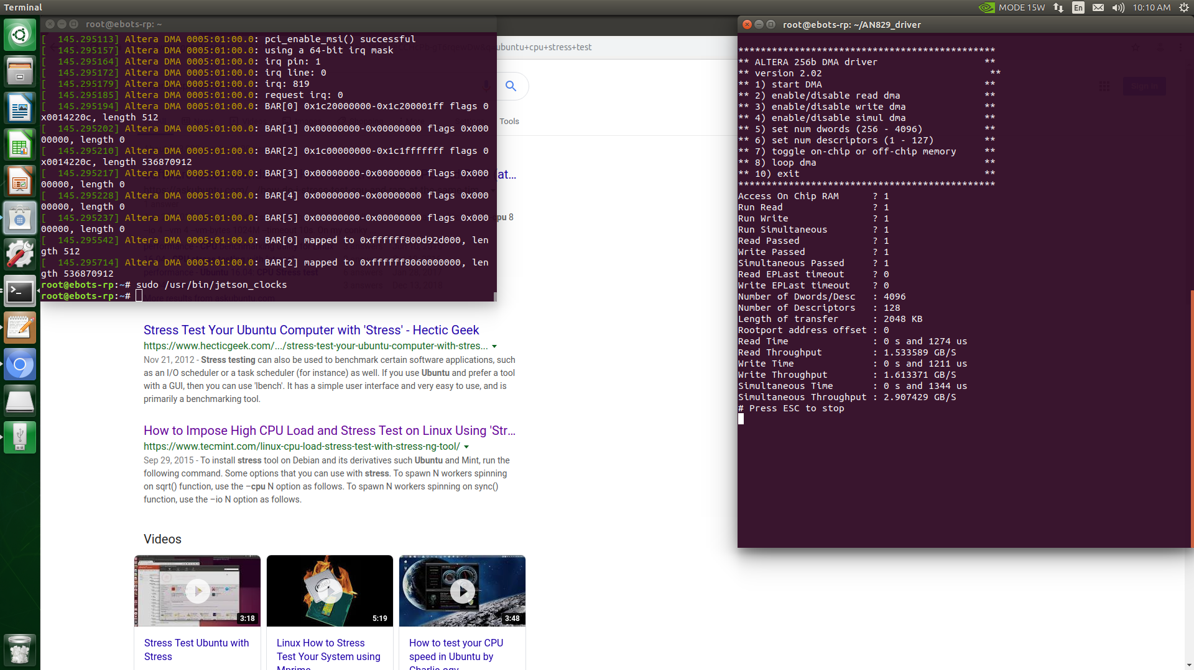
INTEL ARRIA 10 GX DEV KIT – PCIE GEN3x8 DMA
DMA Test Result – PCIe Gen1x8
Length of Transfer: 2048KB
Read Throughput: 1.53GB/s
Write Throughput: 1.61GB/s
Simultaneous Throughput: 2.9GB/s
10/7/2019
14
Copyright © 2019 EBots Inc.
hlam@ebots.com/mkang@ebots.com
Notes:
14

Slide 15
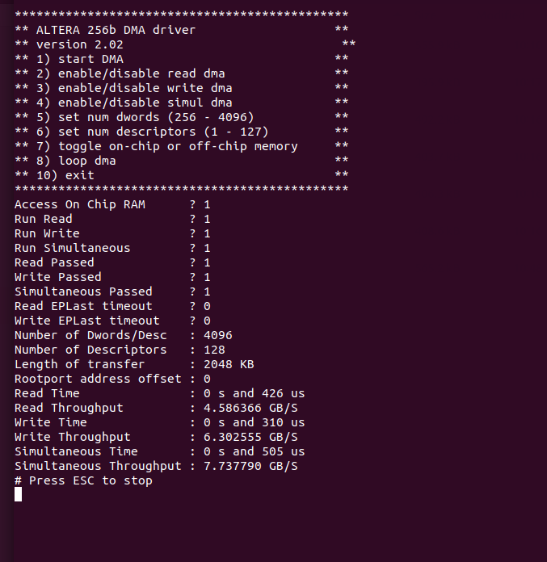
INTEL ARRIA 10 GX DEV KIT – PCIE GEN3x8 DMA
DMA Test Result – PCIe Gen3x8
Length of Transfer: 2048KB
Read Throughput: 4.59GB/s
Write Throughput: 6.30GB/s
Simultaneous Throughput: 7.74GB/s
10/7/2019
15
Copyright © 2019 EBots Inc.
hlam@ebots.com/mkang@ebots.com
Notes:
15

Slide 16
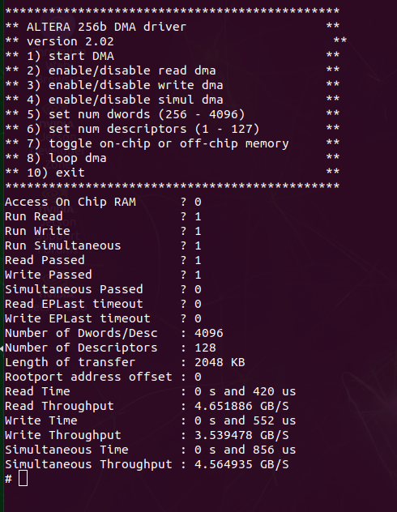
INTEL ARRIA 10 GX DEV KIT – PCIE GEN3x8 DMA
DMA Test Result – PCIe Gen3x8 with External Memory DDR3 ( 2133Mbps, x64 bus width)
Length of Transfer: 2048KB
Read Throughput: 4.65GB/s
Write Throughput: 3.54GB/s
Simultaneous Throughput: 4.57GB/s
Throughput Differences for On-Chip and External Memory
This reference design provides a choice between on-chip memory implemented in the FPGA fabric and external memory available on the PCB. The on-chip memory supports separate read and write ports. Consequently, this memory supports simultaneous read and the write DMAs.
The external memory supports a single port. Consequently, the external memory does not support simultaneous read DMA and write DMA accesses. In addition, the latency of external memory is higher than the latency of on-chip memory. These two differences between the on-chip and external memory result in lower throughput for the external memory implementation.
Source @AN 829: PCI Express* Avalon®-MM DMA Reference Design
10/7/2019
16
Copyright © 2019 EBots Inc.
hlam@ebots.com/mkang@ebots.com
Notes:
16

Slide 17
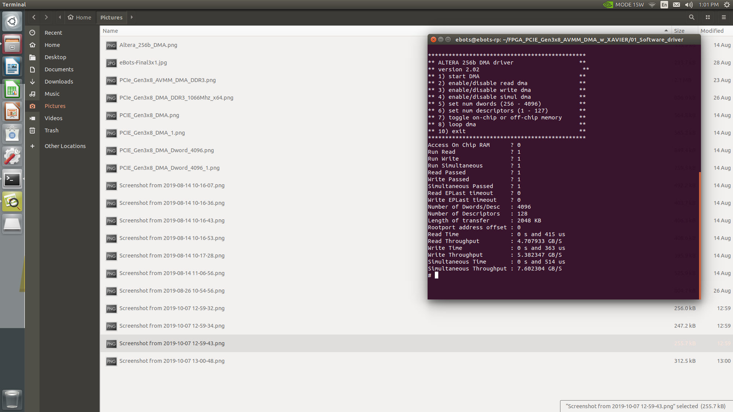
INTEL ARRIA 10 GX DEV KIT – PCIE GEN3x8 DMA
DMA Test Result – PCIe Gen3x8 with External Memory DDR4 ( 2133Mbps, x64 bus width)
Length of Transfer: 2048KB
Read Throughput: 4.70GB/s
Write Throughput: 5.38GB/s
Simultaneous Throughput: 7.60GB/s
Throughput Differences for On-Chip and External Memory
This reference design provides a choice between on-chip memory implemented in the FPGA fabric and external memory available on the PCB. The on-chip memory supports separate read and write ports. Consequently, this memory supports simultaneous read and the write DMAs.
The external memory supports a single port. Consequently, the external memory does not support simultaneous read DMA and write DMA accesses. In addition, the latency of external memory is higher than the latency of on-chip memory. These two differences between the on-chip and external memory result in lower throughput for the external memory implementation.
Source @AN 829: PCI Express* Avalon®-MM DMA Reference Design
10/7/2019
17
Copyright © 2019 EBots Inc.
hlam@ebots.com/mkang@ebots.com
Notes:
17

Slide 18
INTEL ARRIA 10 GX DEV KIT – PCIE GEN3x8 DMA
Comparison table – PCIe Gen3x8 DMA ( RP: x86 vs ARM, DMA: OCM vs DDR3/DDR4)
 | On-Chip-Memory |  | DDR3 |  | DDR4
 | X86⁽¹⁾ | ARM | x86 | ARM | x86⁽²⁾ | ARM
Read | 6.38GB/s | 4.59GB/s | Not tested | 4.65GB/s | 6.62GB/s | 4.70GB/s
 | 79.75% | 57.38% |  | 58.12% | 82.75% | 58.75%
Write | 6.34GB/s | 6.3GB/s | Not tested | 3.54GB/s | 6.26GB/s | 5.38GB/s
 | 79.25% | 78.75% |  | 44.25% | 78.25% | 67.25%
Simultaneous Read/Write | 11.69GB/s | 7.74GB/s | Not tested | 4.56GB/s | 4.05GB/s | 7.60GB/s
NOTE
DDR3 Specification: Running at 1066Mhz, BW at 2133Mbps, Bus width x64
DDR4 Specification: Running at 1066Mhz, BW at 2133Mbps, Bus width x64
ARM based System: Nvidia Jetson Xavier
Source @
(1) AN 829: PCI Express* Avalon®-MM DMA Reference Design
(2) AN708: PCI Express DMA Reference Design Using External Memory
10/7/2019
18
Copyright © 2019 EBots Inc.
hlam@ebots.com/mkang@ebots.com
Notes:
18

Slide 19
THANK YOU
10/7/2019
19
Copyright © 2019 EBots Inc.
hlam@ebots.com/mkang@ebots.com
Notes:
Send RAW8 pixel format
Distortion will be done at software side
NxWxH: round-robin buffer
Frame ID, Beginning of Frame, End of Frame, status flag → when it is done
Data arrangement: Frame1[ABC…]Frame2[ABC…]Frame3[ABC…]… → [AAAA…BBBBB…CCCC….] → for 3D image only, for 2D frame arrangement
Dead Pixel detection
DMA bandwidth
19

